Slide 1

Lecture 3: Project processes
<number> | 2010

Slide 2
Covered in this lecture
Project processes
  Project Planning (PP)
  Project Assessment & Control (PAC)
  Risk Management (RM)
  Configuration Management (CM)
  Information Management (INFOM)
  Measurements (MEAS)
<number> | 2010
Notes:
Coveres main text book chapter 5.

Slide 3
System Life Cycle Processes Overview per ISO/IEC 15288
ORGANIZATIONAL
PROJECT-ENABLING
PROJECT PROCESSES
PROCESSES
Enterprise Environment
Project planning
Project assessment and control
Measurement
Enterprise Environment
Project Portfolio
Management
Management
Management
Management
Infrastructure
Investment
Investment
Investment
Configuration
Configuration
Configuration
Information
Information
Management
Decision
management
Risk
Management
Information
Management
Management
Management
Decision
Decision
-
-
making
making
Risk Management
Risk Management
Management
Management
Management
Management
Management
Management
System Life Cycle
System Life Cycle
Life Cycle Model
Process
Processes
Processes
Guidelines
TECHNICAL PROCESSES
Management
Management
Management
Resource
Resource
Human Resource
Resource
Stakeholder
Stakeholder
Stakeholder
Stakeholder
Requirements
Architectural
Design
Requirements
Requirements
Management
Requirements
Management
Management
Management
Architectural Design
Architectural Design
Requirements
Architectural Design
Requirements
Requirements
Requirements
Analysis
Analysis
Analysis
Definition
Analysis
Definition
Definition
Definition
Quality
Quality
Quality
Quality
Management
Management
Management
Management
Implementation
Implementation
Implementation
Implementation
Integration
Integration
Integration
Integration
AGREEMENT
Verification
Verification
Verification
Verification
Transition
Transition
Transition
Transition
Validation
Validation
Validation
PROCESSES
Validation
Acquisition
Acquisition
Operation
Maintenance
Operation
Operation
Operation
Maintenance
Maintenance
Maintenance
Supply
Supply
Disposal
Disposal
Disposal
<number> | 2010
Notes:
ISO/IEC 15288 identifies four process groups to support systems engineering. Each of these process groups is the subject of a chapter in the text book.
Technical Processes include stakeholder requirements definition, requirements analysis, architectural design, implementation, integration, verification, transition, validation, operation, maintenance, and disposal.
Project Processes include planning, assessment and control, decision management, risk management, configuration management, information management and measurement process.
Organizational Project-enabling processes include project portfolio management, infrastructure management, life-cycle processes management, human resource management, and quality management. The figure illustrates, the outputs of the system life cycle processes management process directs the tailoring of the Technical and Project processes.
Agreement Processes address acquisition and supply.

Slide 4
Project Management and Systems Engineering Overlap
PROJECT
PROJECT
MANAGEMENT
SYSTEMS
PLANNING &
SYSTEMS ENGINEERING
PROJECT PLANNING
AND CONTROL
ENGINEERING
CONTROL
Resource Allocation
Technical Guidelines
Task
Definitions
System
Architecture
Manpower/Facilities
Project Planning
Concept/Architecture
Project Definition
Program Guidelines
Risk
Management
Plans, Schedules, Outputs
Policy/Goals
Systems Integration
Project Control
Resource Allocation
Technical
Coordination
Risk Mgmt,
Config
Mgmt
Budget/Funds
Customer
Interaction
Allocation
Technical Coordination
Sponsor
Financial Contract
Management
System Integration
Interaction
Systems engineers continually interact with project management
<number> | 2010
Notes:
The Venn Diagram depicts the interfaces between Systems Engineering and Project Planning and Control.

Slide 5
Project Planning Process (PP)
Controls
- Enterprise Strategic Plan
- Enterprise Policies & Standards
Activities
- Define Scope, Objectives, and Constraints
- Define WBS,
Work Packages,
Schedules & Budgets
Prepare Project Plans
Establish Project Structure, Roles & Responsibilities
Outputs
Project Plans, WBS &
Data Dictionary
- SEP, tailored CMP, IMP, RMP & QMP
- Key Personnel
& Resources
- Project Performance Measures
Inputs
Proposals
Project Constraints
Roles & Responsibilities
- Resource Requirements Forecast
Enablers
- Enterprise Project Procedures
& Processes
Enterprise Infrastructure
<number> | 2010
Notes:
Purpose: To establish the direction and infrastructure necessary to assess and control the progress of a project, and Identify the details of the work and the right set of personnel/ skills/ facilities with a schedule of need for resources from within and outside the enterprise.
Description:
Inputs: Project proposal and technical results from the initial concept exploration stage.
Activities:
Analyze project proposal; Identify project objectives and project constraints; Define Key Events; Define top level work packages; Develop project schedule; Define costs and estimate project budget
Prepare a Systems Engineering Plan (SEMP); Tailor enterprise Risk Management Processes; Tailor enterprise Configuration Management Processes; Tailor enterprise procedures (see Chapter 10 on tailoring)
Tips:
Use of Integrated Product teams to improve communication
WBS used to promote communication between systems engineering and project management
Shortcuts in the planning process reduces the effectiveness of other project processes
Planning is an essential process
Incorporate risk management early; always attend to the technical risks
Project Management Institute (PMI) is a source of guidelines for project planning

Slide 6
Project Assessment & Control Process (PAC)
Controls
Applicable laws and regulations
Industry standards
Agreements
Project Procedures and Standards
Inputs
Project Plans
Risk profile
Configuration baseline
SEP
WBS
Project schedule
Project budget
Procedures
Reports
Activities
Assess the project
Control the project
Close the project
Outputs
Project Performance Measures assessment
Project status report
Project Directives
Change requests
Enablers
Organization/Enterprise Policies, procedures, and standards
Organization/Enterprise Infrastructure
Project Infrastructure
<number> | 2010
Notes:
Purpose: To collect and evaluate the status of the project comparing the results achieved against the plan to assess the maturity of the project
Assessments are scheduled periodically and for all milestones and decision gates
The intention is to maintain good communications within the project team and within the stakeholders, especially when deviations are encountered
Description: Collects data to evaluate the adequacy of the project infrastructure, the availability of necessary resources, and compliance with project performance measures.
Inputs:
Inputs from the Project Planning Process provide the basis for continuous evaluation of a project against performance, costs, schedule, and business objectives.
Outputs:
Project assessment provides information on the health and maturity of the project work effort.
Results are used to make decisions regarding future work and technical options.
Activities:
Determine actual and projected cost against budget as well as actual and projected time against schedule; Evaluate effectiveness of personnel
Evaluate adequacy and availability of project infrastructure. Evaluate project progress. Conduct required reviews and audits to determine readiness to meet milestones. Monitor critical tasks and new technologies. Recommend adjustments to project plans. Communicate status as agreed upon.

Slide 7
Decision management Process (DM)
Controls
- Enterprise Strategic Plan
- Enterprise Policies & Standards
Inputs
Problem or decision gate
History of prior decisions
Assessment from all relevant persons
Activities
Define strategy; success criteria
Define and evaluate alternatives
Involve relevant persons
Make and record decision
Outputs
Strategy
Preferred course of action
Decision rationale documents
Enablers
- Enterprise Project Procedures
& Processes
- Enterprise Infrastructure
<number> | 2010
Notes:
Purpose: To make decisions throughout the life cycle of every system. Milestones and decision gates are the most formalized. Documentation of every decision with their rationale supports future decision making
Description:
Focus of decisions and thus the personnel on desired results
Decisions require: Analysis of each alternative, Selection of most appropriate alternative, Supporting documentation
All decisions are taken within the context of an enterprise
Inputs:
2 methods of decision making: As scheduled by plan and Issues arising from a stakeholder
Prior history should be considered
All relevant stakeholders should be involved
The enterprise provides the contextual policies, procedures, and standards.
Outputs:
Approved decision is documented along with: Rationale, Assumptions, Constraints and supporting analysis
Recorded and communicated
Activities:
Identify need for decision. Involve all personnel with relevant knowledge and experience. Evaluate consequences of alternatives. Record the decision. Communicate decision/ new directions

Slide 8
Risk Management Process (RM)
Controls
- Enterprise Strategic Plan
- Enterprise Policies & Standards
Inputs
Project risk assessments
Prior Risk Matrix
Project plans & performance
Activities
Identify risk items
Analyze and prioritize risk items
Specify strategy for each risk item
Communicate risk status and actions
Outputs
Risk Matrix; status, priority, strategy
Risk mitigation action plan
Enablers
- Enterprise Project Procedures
& Processes
- Enterprise Infrastructure
<number> | 2010
Notes:
Purpose: To deal with uncertainty that is present throughout the entire system life-cycle
Objective: To achieve a proper balance between risk and opportunity
Avoidance of cost, schedule, performance/technical risks
Risk and opportunity are managed in accordance with enterprise strategy
Description:
New and modified systems are based on pursuit of opportunity
Risk is always a factor in systems and should be evaluated in terms of the opportunity sought
Risk can be caused by external or internal issues impacting: Cost, Schedule, Technical, Programmatic (see Chapter 7)
Ambient Risk: caused by surrounding environment (external)
Uncertainty: all projects have uncertain events and are dealt with under risk management (internal)
Manage both threats and opportunities proactively
Inputs:
A risk management plan is tailored to the individual project procedures for risk management
Documentation is often maintained as a risk matrix
Outputs:
Risk Matrix contains findings of Risk Management process
Action plans are developed for selected risks in order to assure proper response to identified risks
Change request may be used to mitigate technical risk
Activities:
Identify and define risk situations
Analyze risks for likelihood and severity
Define handling scheme and required resources for each risk
Generate a plan of action when risk threshold is exceeded
Maintain record of risk items and how they were handled
Maintain communication of risk and related actions
Tips:
To identify/determine validity of a risk, pose each as an “If… Then …” statement
Document everything to preempt related unforeseen issues
Encourage the identification of risk potential -- do not adversely impact identification with negative feedback
Use of analysis – FMECA
Use metrics/ measurements and statistics
Project Management Institute –good source for information on Risk Management
Institute of Risk Management has generated “ The Risk Management Standard”
See Forsberg, et al for additional info on opportunity management

Slide 9

Risk = Probability * Impact
<number> | 2010

Slide 10
Level of Risk Depends upon both Likelihood and Consequence (Probability * impact)
High
High
Risk
Consequence
Medium Risk
Low Risk
Low
Low
Likelihood
High
<number> | 2010
Notes:
Risk has two components -- the likelihood that an undesirable event will occur and the consequence of the event if it does occur.
The likelihood that an undesirable event will occur often is expressed as a probability.
The consequence of the event is expressed in terms that depend on the nature of the event (e.g., dollars, performance loss).
The combination of low likelihood and benign consequences gives low risk, while high risk is produced by high likelihood and severe consequences.
By changing the adjective from undesirable to desirable the noun changes from risk to opportunity, but the diagram remains the same.
As suggested by the shading, most projects experience a comparatively small number of high risk or high opportunity events.

Slide 11
Risk Management Process Activities
Risk Identification
Risk Assessment
Risk Handling
Risk Tracking and Control
Risk Mitigation
<number> | 2010
Notes:
A risk management plan encompasses the entire project, so that the project can achieve and maintain an acceptable level of risk.
The results should be included in the Systems Engineering Management Plan and risk should be considered in defining the Systems Engineering Management Schedule.

Slide 12
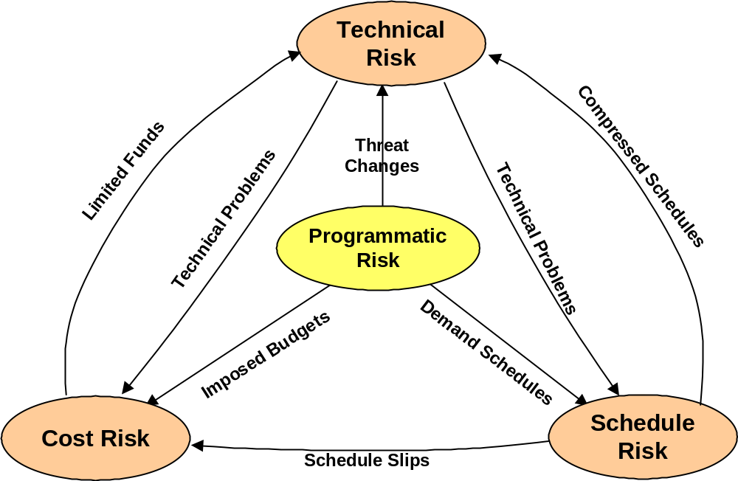
Typical Relationships Among the Risk Categories
Mission
Changes
<number> | 2010
Notes:
Technical risk: is the possibility that a technical requirement of the system may not be achieved in the systems life cycle. Technical risk exists if the system may fail to achieve performance requirements; to meet operability, producibility, testability, integration requirements; or to meet environmental protection requirements. A potential failure to meeting any requirement which can be expressed in technical terms is a source of technical risk.
Cost risk: is the possibility that available budget will be exceeded. Cost risk exists if the project must devote more resources than planned to achieve technical requirements; if the project must add resources to support slipped schedules due to any reason; if changes must be made to the number of items to be produced; or, if changes occur in the enterprise or national economy. Cost risk can be predicted at the total project level or for an element. The collective effects of element-level cost risks can produce cost risk for the total project.
Schedule risk: is the possibility that the project will fail to meet schedule milestones. Schedule risk exists if there is inadequate allowance for acquisition delays. Schedule risk exists if difficulty is experienced in achieving scheduled technical accomplishments, such as the development of software. Schedule risk can be incurred at the total project level for milestones such as deployment of the first element. The cascading effects of element-level schedule risks can produce schedule risk for the total project.
Programmatic risk: is produced by events which are beyond the control of the project manager. These events often are produced by decisions made by personnel at higher levels of authority. Programmatic risks can be produced by reductions in project priority, by delays in receiving authorization to proceed with a project, or by reduced or delayed funding, by changes in national objectives, etc. Programmatic risk can be a source of risk in any of the other three risk categories.

Slide 13
Configuration Management Process (CM)
Controls
- Enterprise Strategic Plan
- Enterprise Policies & Standards
Inputs
Configuration baseline(s)
Change requests
CMP
Activities
Identify items for configuration management
Assess and control changes to items
Communicate status of controlled items
Maintain baseline currency
Outputs
Configuration baseline(s)
Baseline control
Documented status and impact of change request
Enablers
- Enterprise Project Procedures
& Processes
- Enterprise Infrastructure
<number> | 2010
Notes:
CM is the practice of applying technical and administrative direction, surveillance, and services to:
• Identify and document the characteristics of system elements such that they are unique and accessible in some form; assign a unique identifier to each version of each system element;
• Establish controls to allow changes in those characteristics; ensure consistent product versions;
• Record, track, and report status pertaining to change requests or problems with a product; maintain comprehensive traceability of all transactions.
Purpose: To ensure the management of the evolving system - both hardware and software, . Fundamental to this is the establishment, control and maintenance of hardware and software baselines.
The purpose of Configuration Management (CM) is to establish and maintain control of requirements, documentation, and artifacts produced throughout the system’s life cycle.
Description:
CM ensures the product functional, performance, and physical characteristics are properly identified, documented, validated, and verified
Evolving system requirements must be added and managed
Inputs:
In the Project Planning Process a CM Plan is tailored to satisfy individual project procedures
Need for change requests occurs during the project assessment process
Outputs:
Primary output of CM is maintenance of the configuration baseline for the system and all system elements
Documentation is developed and supports the systems engineering reviews, strategies, and production
Activities:
Identify elements to be maintained under configuration control. Maintain information to ensure system/ product integrity. Implement a Configuration Control Cycle to incorporate: evaluation, validation, and verification of engineering change requests. Develop and maintain configuration control documentation. Perform Configuration Audits at milestones to validate the baseline

Slide 14
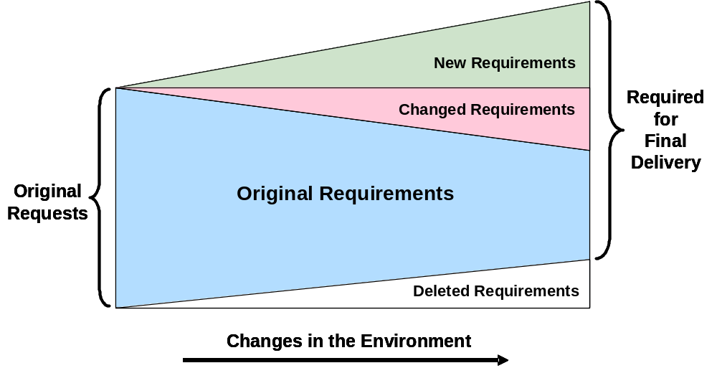
Configuration Management
Requirements changes are inevitable
<number> | 2010
Notes:
Change is inevitable, as indicated in Figure 8-2, and managing the impact of change on a project is the work of CM.
Systems engineers ensure that the change is necessary, and that the most cost-effective recommendation has been proposed.
It is important also to ask: “What is the impact of not making the change?” especially as the system matures, since changes made later in the life cycle have an increasing risk of hidden impacts which can adversely affect system cost, schedule, and technical performance.

Slide 15
Information Management Process (INFOM)
Controls
- Enterprise Strategic Plan
- Enterprise Policies & Standards
Inputs
System-relevant information
Data dictionary
IMP
Activities
Identify information to be managed
Define representations
Transform, maintain, publish information
Outputs
Published, current, valid system information
Enablers
- Enterprise Project Procedures
& Processes
- Enterprise Infrastructure
<number> | 2010
Notes:
Purpose: To ensure that information is properly stored, maintained, secured, and accessible to those who need it thereby establishing/ maintaining integrity of relevant system life cycle artifacts
Description:
Information exists in many forms and has varying degrees of value
Information assets have become pervasive
Impact of threats to secure access, confidentiality, integrity, and availability of information can cripple the ability to get work done
IM provides the basis for the management of and access to information throughout the lifecycle
Maintenance of historical information on decision making is the responsibility of information management
Input:
IM Plan is tailored to satisfy individual project procedures for information management
Identifies system information to be collected, retained, secured, and disseminated
Output:
Availability of information regarding the documented system project
Activities:
Establish and maintain system data dictionary
Define system relevant information
Define formats and media required to be documented/ retained
Identify valid sources of information
Retrieve and distribute information
Archive or retire in accordance with established procedures

Slide 16
Measurement Process (MEAS)
Controls
Applicable laws and Regulations
Industry Standards
Agreements
Project Procedures and Standards
Project Directives
Inputs
Measurement of effectiveness needs and data
Measurement of Performance needs and data
Technical Performance Measures needs and data
Project Performance Measures needs and data
Organizational Process Performance Measurements needs
Organizational Process Performance data
Activities
Define strategy; success criteria
Define and evaluate alternatives
Involve relevant persons
Make and record decision
Outputs
Measurement Strategy
Measurement repository
Measurement report
Measurement Evaluation Report
Enablers
Organization/Enterprise Policies,
Procedures and Standards
Organization/Enterprise infrastructure
Project Infrastructure
<number> | 2010

